Slide 1
Topic 5.2 Hierarchical Clustering Algorithm
Hierarchical Clustering Algorithm

Slide 2
Hierarchical Clustering
The Hierarchical method works by grouping data objects(records) into a tree of clusters.
Uses distance(similarity) matrix as clustering criteria. We provide a termination condition
Classified Further as
Agglomerative Hierarchical Clustering
Divisive Hierarchical Clustering

Slide 3
Agglomerative Hierarchical Clustering
Data objects are grouped in a bottom-up fashion.
Initially each data object is in its own cluster.
Then merge these atomic clusters into larger and larger clusters, until all of the objects are in a single cluster or until certain termination conditions are satisfied.
Termination condition can be specified by the user, as the desired number of clusters.

Slide 4
Divisive Hierarchical Clustering
In this data objects are grouped in a top down manner
Initially all objects are in one cluster
Then the cluster is subdivided into smaller and smaller pieces, until each object forms a cluster on its own or until it satisfies certain termination conditions as the desired number of clusters is obtained.

Slide 5
AGNES and DIANA (Agglomerative Nesting) (Divisive Analysis) Agglomerative and divisive hierarchical clustering on data objects {a, b, c, d ,e }
Step 0
Step 1
Step 2
Step 3
Step 4
agglomerative
(AGNES)
a
a b
b
a b c d e
c
c d e
d
d e
e
divisive
(DIANA)
Step 4
Step 3
Step 2
Step 1
Step 0

Slide 6
AGNES-Algorithm
Given a set of N objects to be clustered, and an N*N distance (or similarity) matrix, the basic process of hierarchical clustering (defined by S.C. Johnson in 1967) is this:
Start by assigning each object to a cluster, so that for N objects, we have N clusters, each containing just one object. Let the distances (similarities) between the clusters the same as the distances (similarities) between the objects they contain.
Find the closest (most similar) pair of clusters and merge them into a single cluster, so that now we have one cluster less.
Compute distances (similarities) between the new cluster and each of the old clusters.
Repeat steps 3 and 4 until all items are clustered into a single cluster of size N.

Slide 7
… Continue
Step 4 can be done in different ways, and this distinguishes single-linkage, complete linkage and average-linkage clustering

Slide 8
Single Linkage and Complete Linkage
For Single Linkage: distance between one cluster and another cluster is equal to the shortest distance from any member of one cluster to any member of the other cluster
It produces clusters with the property that every member of a cluster is more closely related to at least one member of its cluster than any point outside it.
For Complete Linkage: distance between one cluster and another cluster to be equal to the greatest distance from any member of one cluster to any member of the other cluster.
It produces cluster with the property that all members lay within some known maximum distance of one another.

Slide 9
Define Inter-Cluster Similarity
MIN
MAX
Group Average
Similarity?
distance

Slide 10
Define Inter-Cluster Similarity
distance = shortest distance, nearest neighbor clustering algorithm
MIN Linkage
MAX Linkage
Group Average

Slide 11
Define Inter-Cluster Similarity
distance = longest distance , farthest neighbor clustering algorithm
MIN Linkage
MAX Linkage
Group Average Linkage

Slide 12
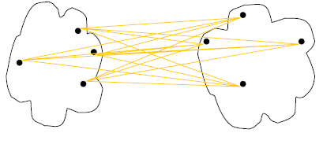
Define Inter-Cluster Similarity
average-link clustering, distance = average distance
MIN Linkage
MAX Linkage
Group Average Linkage

Slide 13
Single Linkage Hierarchical Clustering Example
Initially “Every point is its own cluster”

Slide 14
Single Linkage Example
“Every point is its own cluster”
Find “most similar(distance)” pair of clusters

Slide 15
Single Linkage Hierarchical Clustering Example…
“Every point is its own cluster”
Find “most similar” pair of clusters
Merge it into a parent cluster

Slide 16
… CONT
“Every point is its own cluster”
Find “most similar” pair of clusters
Merge it into a parent cluster
Repeat

Slide 17
Showing Below How a Hierarchical Tree is Formed

Slide 18
Example: Single Linkage Method
Clustering people by weight using agglomeration clustering.
Objective
cluster students by weight
Metric
the distance between two students is simply the difference in their weights

Slide 19
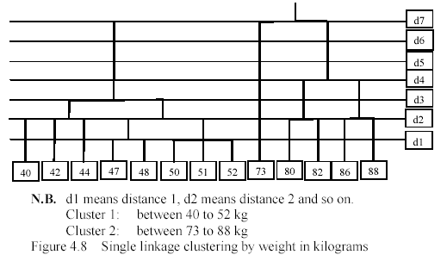
1. Sort the participants by weights
2. Cluster records that are 1 kg apart, then 2kg, and so on
Diagram after seven iterations with clusters remaining

Slide 20
What is a good cluster?
It is one where members have
high degree of similarity
(lowest variance between member)
and the clusters themselves are widely spaced.
Eg age difference is small.

Slide 21
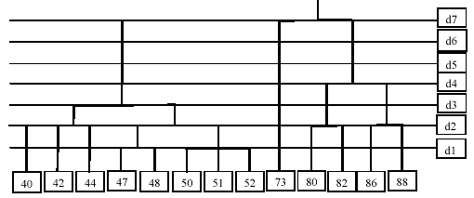
Distance within a cluster: 40, 42 is 2 kg
Distance between two clusters: 73 minus 52 = ? kg

Slide 22
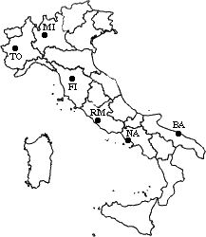
Example 2 :A hierarchical clustering of distances in kilometers between some Italian cities. The method used is single-linkage.
 | BA | FI | MI | NA | RM | TO
BA | 0 | 662 | 877 | 255 | 412 | 996
FI | 662 | 0 | 295 | 468 | 268 | 400
MI | 877 | 295 | 0 | 754 | 564 | 138
NA | 255 | 468 | 754 | 0 | 219 | 869
RM | 412 | 268 | 564 | 219 | 0 | 669
TO | 996 | 400 | 138 | 869 | 669 | 0

Slide 23
Procedure
The nearest pair of cities is MI and TO, at distance 138. These are merged into a single cluster called "MI/TO". The level of the new cluster is L(MI/TO) = 138 and the new sequence number is m = 1. Then we compute the distance from this new compound object to all other objects. In single link clustering the rule is that the distance from the compound object to another object is equal to the shortest distance from any member of the cluster to the outside object. So the distance from "MI/TO" to RM is chosen to be 564, which is the distance from MI to RM, and so on.

Slide 24
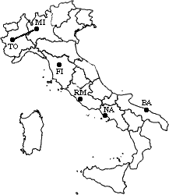
Step-1, Input Distance Matrix L=0 for all clusters
 | BA | FI | MI/TO | NA | RM
BA | 0 | 662 | 877 | 255 | 412
FI | 662 | 0 | 295 | 468 | 268
MI/TO | 877 | 295 | 0 | 754 | 564
NA | 255 | 468 | 754 | 0 | 219
RM | 412 | 268 | 564 | 219 | 0

Slide 25
Step-2,
min d(i,j) = d(NA,RM) = 219 => merge NA and RM into a new cluster called NA/RM L(NA/RM) = 219 m = 2
 | BA | FI | MI/TO | NA/RM
BA | 0 | 662 | 877 | 255
FI | 662 | 0 | 295 | 268
MI/TO | 877 | 295 | 0 | 564
NA/RM | 255 | 268 | 564 | 0

Slide 26
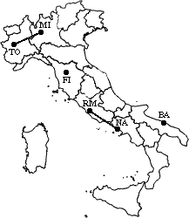
min d(i,j) = d(BA,NA/RM) = 255 => merge BA and NA/RM into a new cluster called BA/NA/RM L(BA/NA/RM) = 255 m = 3
 | BA/NA/RM | FI | MI/TO
BA/NA/RM | 0 | 268 | 564
FI | 268 | 0 | 295
MI/TO | 564 | 295 | 0

Slide 27
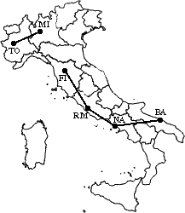
min d(i,j) = d(BA/NA/RM,FI) = 268 => merge BA/NA/RM and FI into a new cluster called BA/FI/NA/RM L(BA/FI/NA/RM) = 268 m = 4
 | BA/FI/NA/RM | MI/TO
BA/FI/NA/RM | 0 | 295
MI/TO | 295 | 0

Slide 28
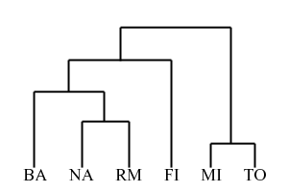
Finally, we merge the last two clusters at level 295. The process is summarized by the following hierarchical tree:

Slide 29
Advantages of single linkage clustering:
Is simple and outputs a hierarchy, a structure that is more informative
It does not require us to pre-specify the number of clusters
Disadvantages of single linkage clustering:
Selection of merge or split points is critical as once a group of objects is merged or split, it will operate on the newly generated clusters and will not undo what was done previously.
Thus merge or split decisions if not well chosen may lead to low-quality clusters

Slide 30
Summary of Hierarchical Clustering Methods
No need to specify the number of clusters in advance.
Hierarchical structure maps nicely onto human intuition for some domains
They do not scale well: time complexity of at least O(n2), where n is the number of total objects.
Like any heuristic search algorithms, local optima are a problem.
Interpretation of results is (very) subjective.

